Slide 1
Software development for automated experiments on singlet oxygen generation mechanisms
Student: Bogdan Klimov, group 22357
Supervisor: Kirill Yershov, PhD (Physics and Mathematics)
Location: Institute of Chemical Kinetics and Combustion SB RAS

Slide 2
Presentation plan
Research area
Relevance of work
Target and tasks
Work schedule
Equipment and software architecture
What has already been done
Expected results

Slide 3
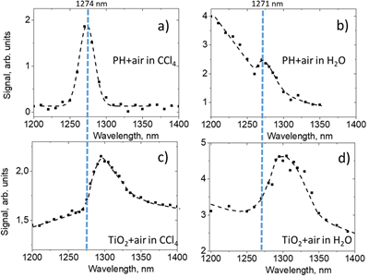
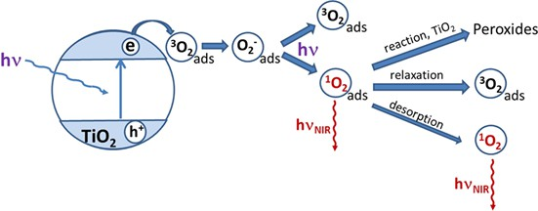
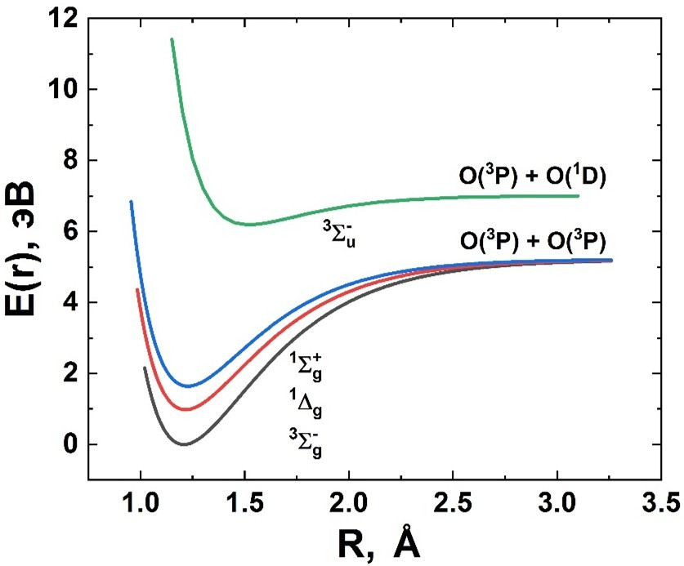
Research area
The essence: automation of experimental research, including equipment control and real-time data processing.
The area: physical chemistry, photochemistry, molecular spectroscopy, automation.

Slide 4
Relevance
Conducting an experiment to record IR spectra and signals during singlet oxygen generation manually makes it difficult to study its generation mechanisms in highly active complexes. This is because reading and processing the data takes a lot of time and requires the researcher to be constantly present.
Also, speeding up the reading and processing is necessary when the photo-excited compound responsible for singlet oxygen generation is consumed quickly.
This work will help reduce experiment time, increase accuracy, and lower the risk of errors.

Slide 5
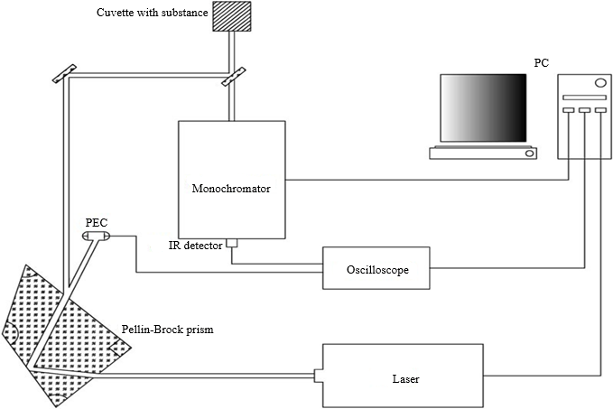
Target
Reduce the speed of the experiment to study the mechanisms of singlet oxygen generation and increase the accuracy of calculations.

Slide 6
Tasks
1. Create software to control all components of the experiment. This includes:
Controlling the laser wavelength via the OPO.
Controlling the passband and step size for the monochromator.
Setting the number of wavelength scan repetitions.
2. The software must handle automatic data collection from equipment:
Reading the signal from the oscilloscope and the energy meter.
Based on the oscilloscope data, calculate the IR luminescence spectrum by integrating the signal. The integration boundaries will be set interactively. The obtained spectrum will then be approximated.
Data from the energy meter will be used to monitor laser pulse energy in real time. It will also help measure the dependence of the signal amplitude (from the oscilloscope) on the laser pulse energy. This is important for determining singlet oxygen generation mechanisms and for measuring the singlet oxygen quantum yield for new or poorly studied compounds.
3. Implement automatic calibration via the software using a known substance or an LED. This is crucial for accurately determining IR luminescence spectra of singlet oxygen during photoexcitation of poorly studied substances. This will allow the program to verify the correctness of the monochromator's wavelength.
4. Test the software under real experimental conditions. Evaluate its speed, accuracy, and ease of use compared to manual methods.

Slide 7
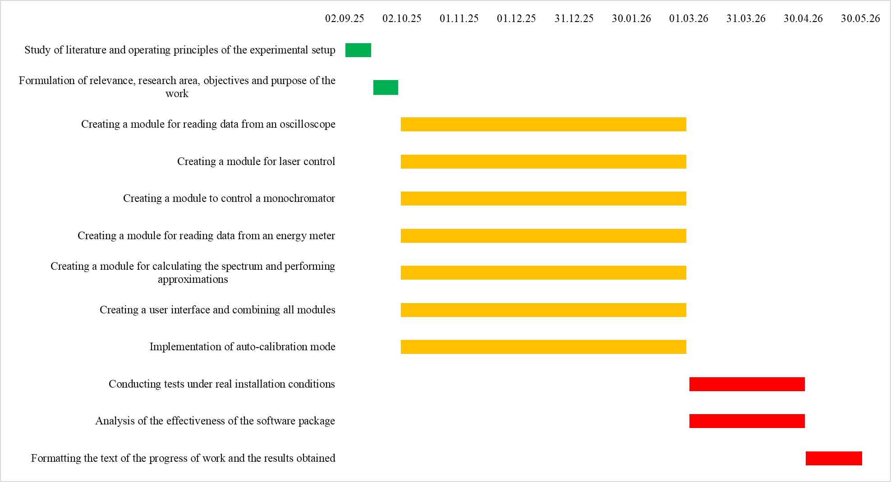
Work schedule

Slide 8
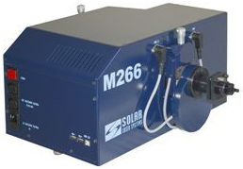
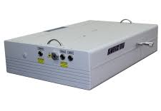
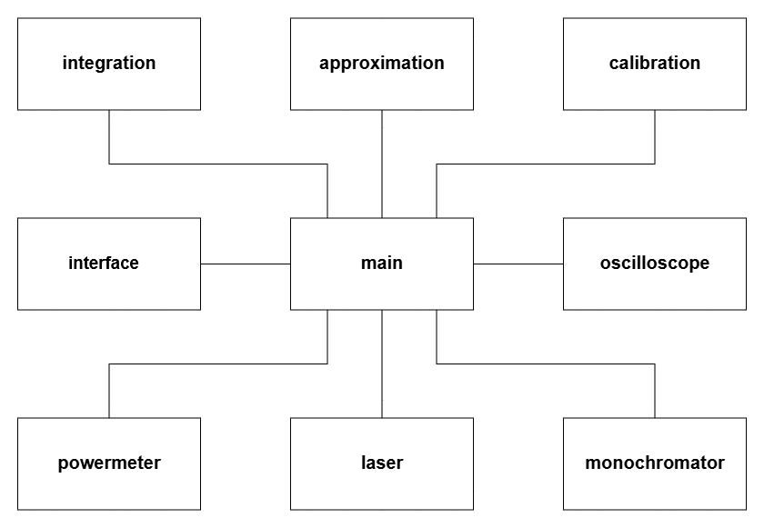
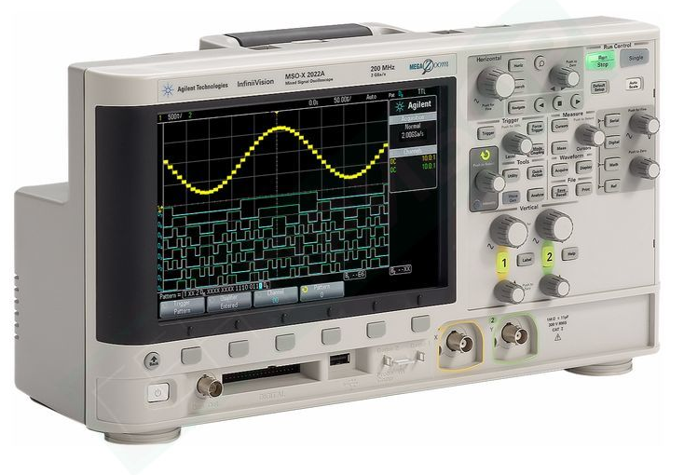
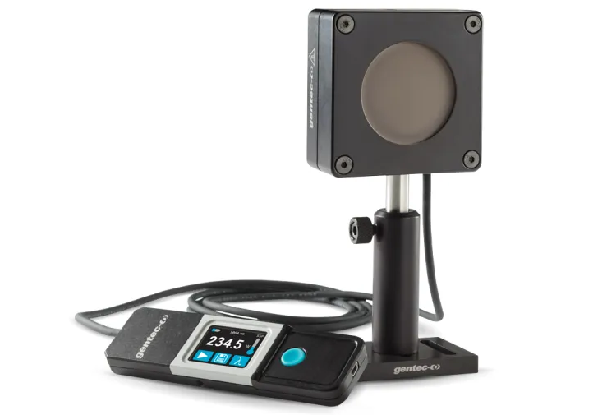
Equipment and software architecture
Monochromator M266-IV (Solar Laser Systems)
Laser radiation LS-2145-OPO (OPO, Lotis Tii 2145)
Software diagram
Oscilloscope MSOX2024A (Keysight)
Energy meter QE25SP-S-MT-D0 (Gentec-EO)

Slide 9
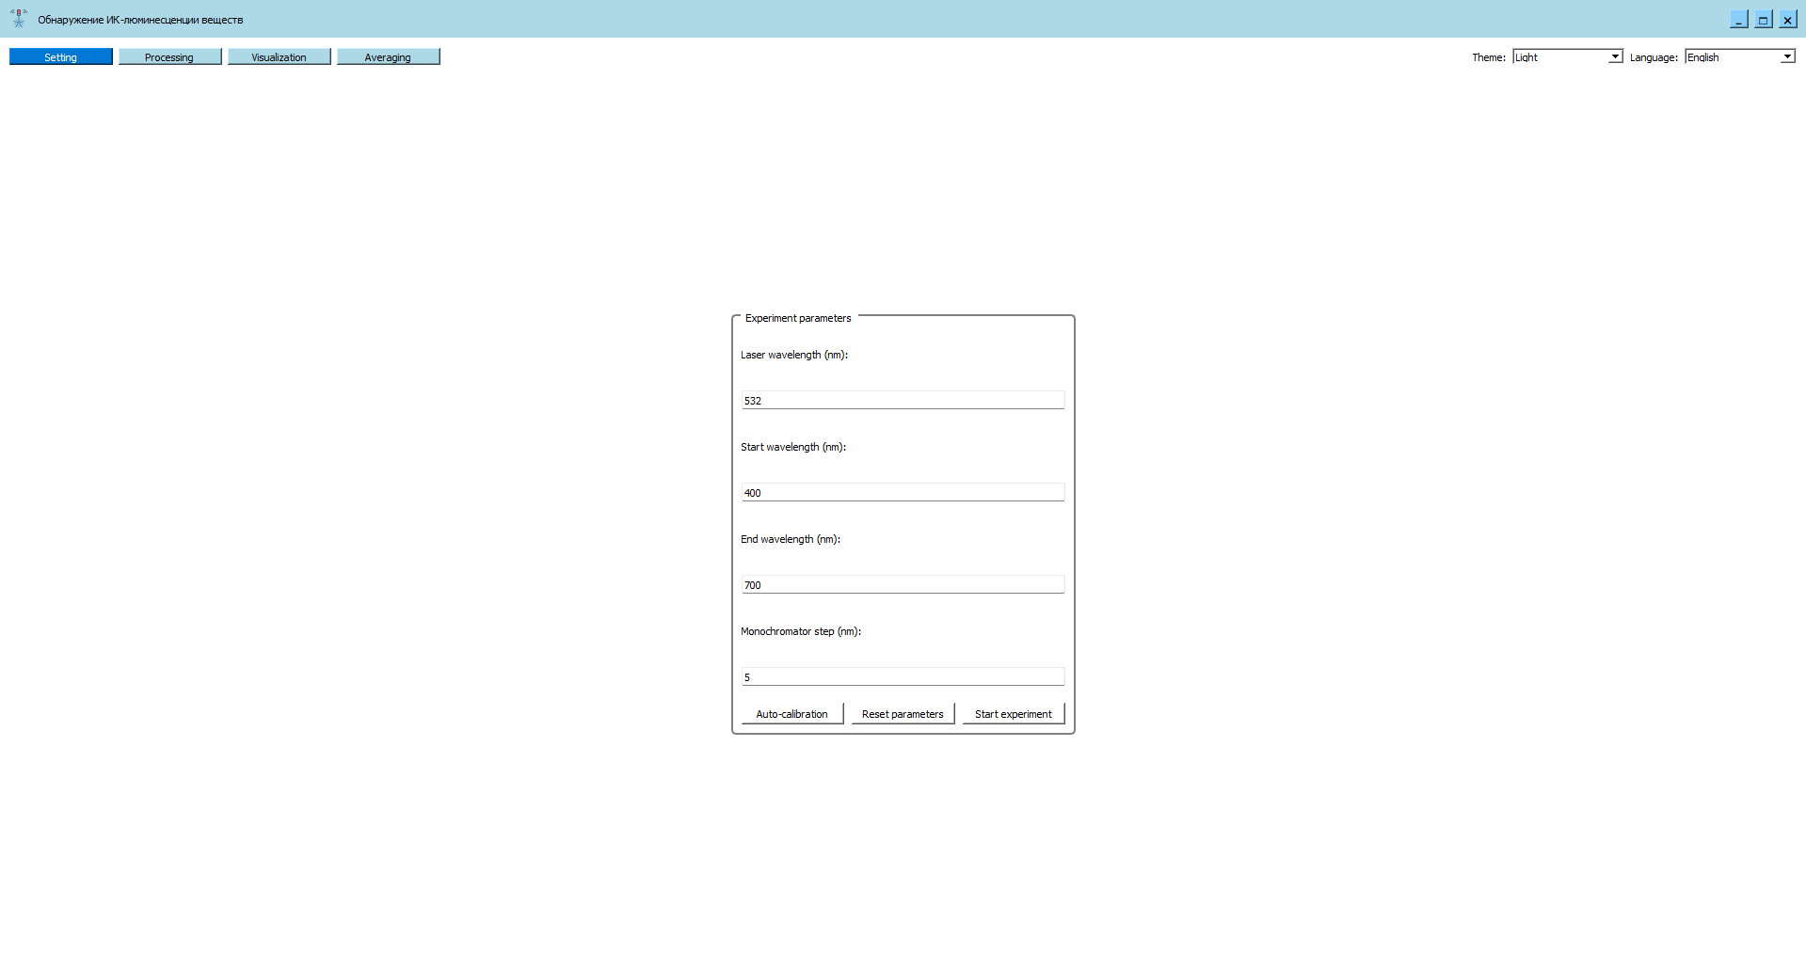
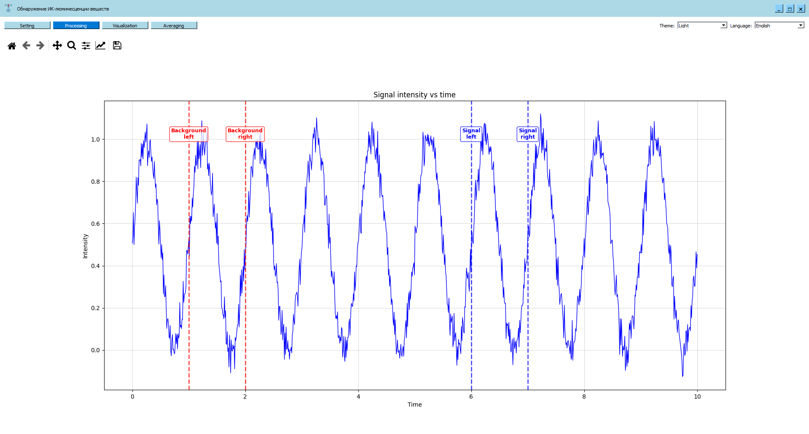
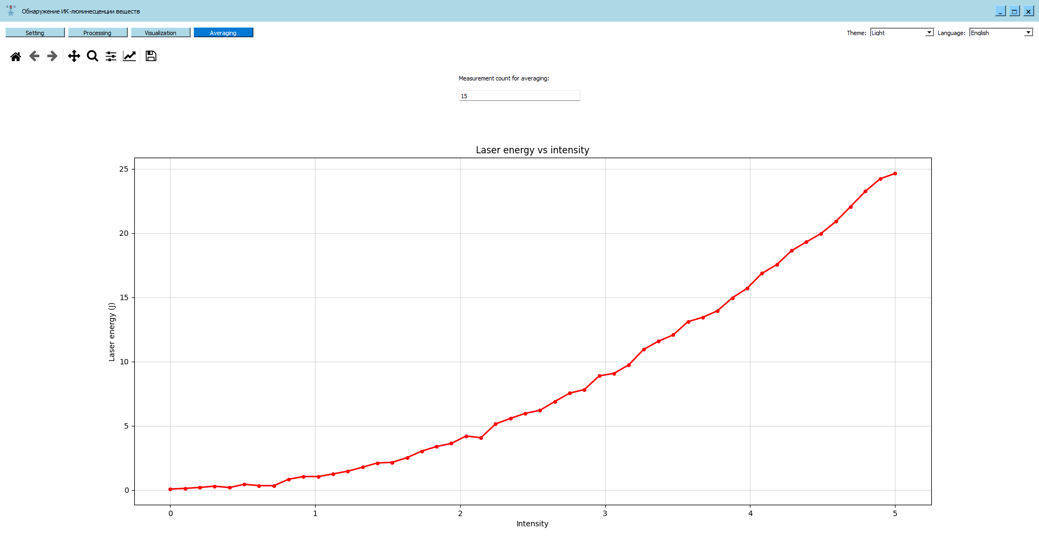
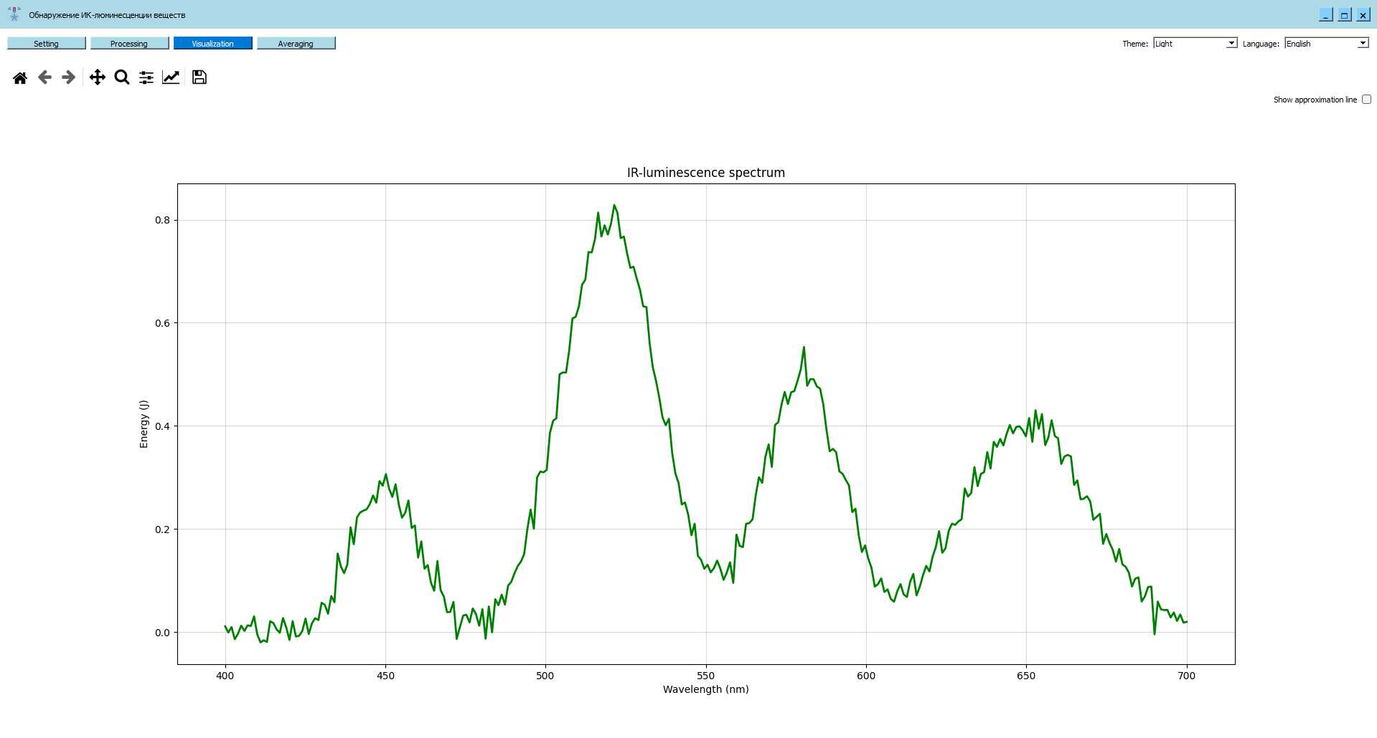
What has already been done

Slide 10
Expected results
1. A formalized algorithm for conducting experiments will be developed and implemented in the software. This will allow for faster and more accurate acquisition of singlet oxygen IR luminescence spectra, specifically spectra dependent on the laser excitation wavelength.
2. Software will be developed to collect data from the oscilloscope and energy meter and process it immediately. The processing will use two independent methods to calculate the spectrum and analyze the intensity vs. energy dependence.
3. An integrated automatic calibration procedure will be implemented and tested. It will use a reference substance or an LED with known spectral characteristics.
4. The software will be tested under real experimental conditions.

Slide 11
Thank you for your attention!

